Slide 1
Resume Matching With Job Description Using PDFs CVs
Abdul Jaweed• 19.Sept.2023

Slide 2
Overview
Introduction
Step 1 : Resume Keywords Extraction and Fetching Job Description Data
Step 2 : Text Preprocessing and Tokenization
Step 3 : Extracting Word Embeddings
Step 4 : Performing Resume Matching
Challenges Faced
Conclusion

Slide 3
Introduction
This project aims to streamline the process of matching job candidates with job descriptions by leveraging natural language processing (NLP) techniques. By extracting resume keywords, fetching job description data, preprocessing text, and performing word embedding, we enable efficient and effective resume-job description matching. This presentation provides insights into each step of the project, highlighting the challenges faced and solutions implemented for successful execution.

Slide 4
Step 1 - Data Collection
Successfully extracted specific resume keywords such as job title, skills, qualifications, and experience using PyPDF2 and SpaCy libraries.
Utilized the HuggingFace dataset library to retrieve job description data.

Slide 5
Step 2 - Preprocessing and Tokenization
Conducted thorough text preprocessing, which included cleaning and formatting, to enhance the quality of both resumes and job descriptions.
Implemented tokenization techniques to break down text data into meaningful units, enabling more efficient analysis and matching.
Addressed challenges related to text normalization and handling special characters to ensure accurate tokenization.

Slide 6
Step 3 - Word Embedding Extraction
Discuss the challenges:
Challenge 1: Efficient computation of word embeddings.
Challenge 2: Managing memory constraints.
Explain the solutions:
Solution 1: Use of the DistilBERT model.
Solution 2: Storage of embeddings in '.npy' format.

Slide 7
Step 4 - Resume Matching
Present the challenges:
Challenge 1: Calculating cosine similarity efficiently.
Challenge 2: Ranking and selecting the top 5 resumes.
Challenge 3: Effective storage and presentation of results.
Describe the solutions:
Solution 1: Utilizing scikit-learn's cosine_similarity.
Solution 2: Employing NumPy for sorting and selection.
Solution 3: Saving results in JSON and DataFrame formats.

Slide 8
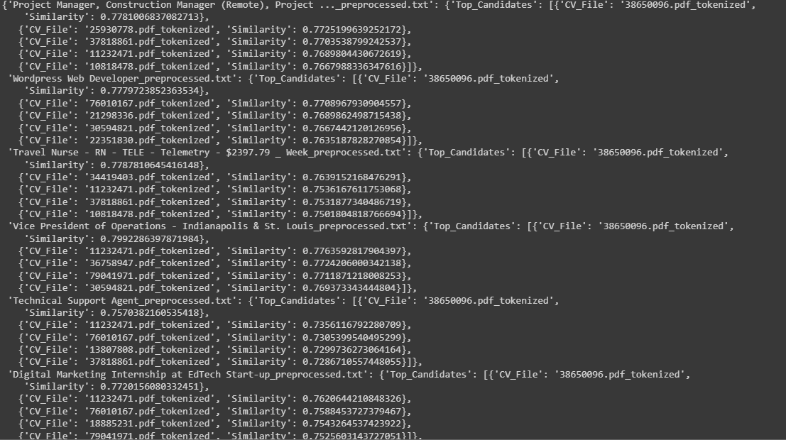
Final Result Image

Slide 9
Challenges Faced
Extracting resume keywords and fetching job descriptions from external sources presented initial complexities.
Consistent text formatting and language handling for resumes and job descriptions required meticulous processing.
Extracting embeddings for a large dataset demanded substantial computational resources.
Efficiently organizing and storing embeddings for quick retrieval posed storage challenges.
Cosine similarity calculations between job descriptions and resumes were resource-intensive.

Slide 10
Conclusion
Addressed significant challenges in keyword extraction from resumes using PyPDF2 and SpaCy libraries.
Leveraged the HuggingFace dataset library for streamlined access to comprehensive job descriptions.
Emphasized the importance of efficient resource utilization and result storage for successful project execution.
Highlighted the role of text preprocessing and tokenization in preparing data for analysis and matching.
Recognized the project's impact on enhancing recruitment procedures and job-candidate matching.
Underlined the value of robust text data handling techniques in the modern job market landscape.

Slide 11
Thank you

